Slide 1
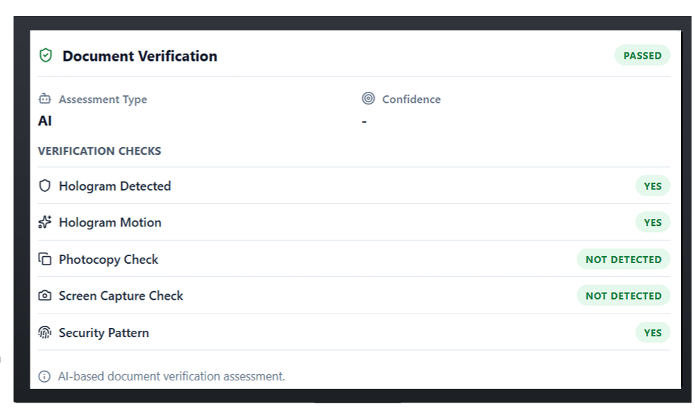
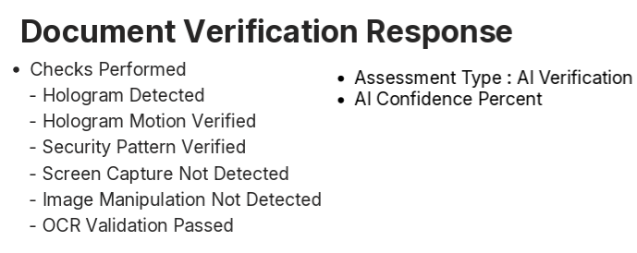
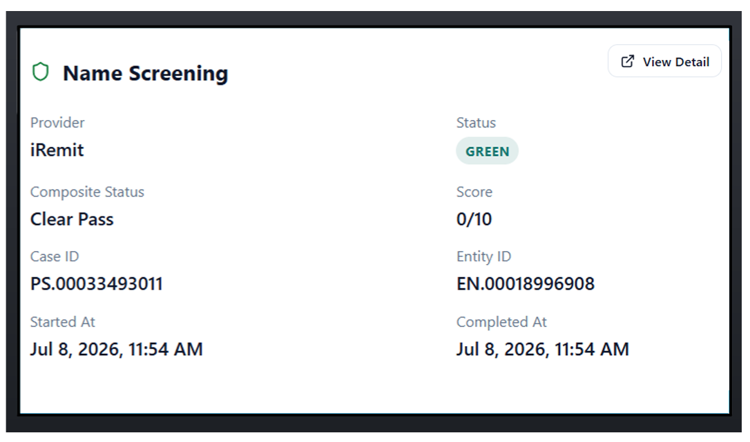
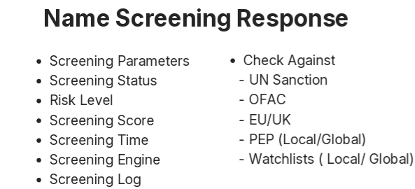
Inficare proposal

Slide 2
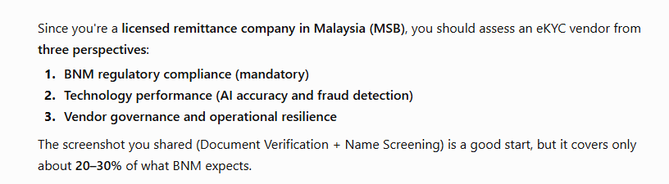
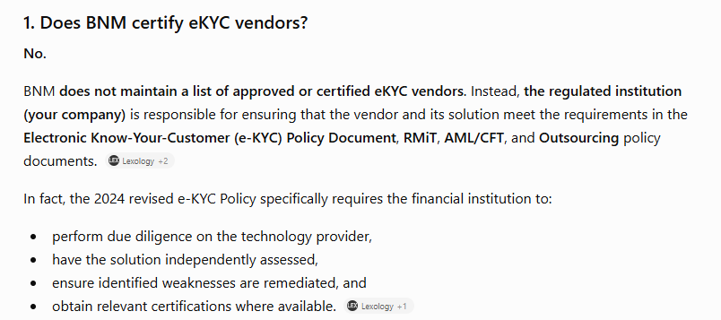
1. Keys take away

Slide 3
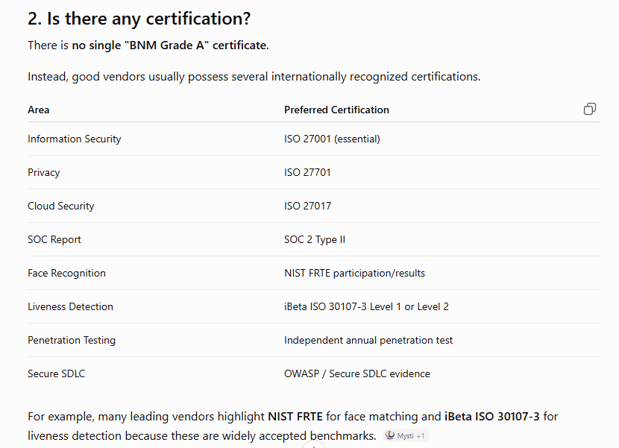
Area | Preferred Certification
Information Security | ISO 27001 (essential)
Privacy | ISO 27701
Cloud Security | ISO 27017
SOC Report | SOC 2 Type II
Face Recognition | NIST FRTE participation/results
Liveness Detection | iBeta ISO 30107-3 Level 1 or Level 2
Penetration Testing | Independent annual penetration test
Secure SDLC | OWASP / Secure SDLC evidence

Slide 4
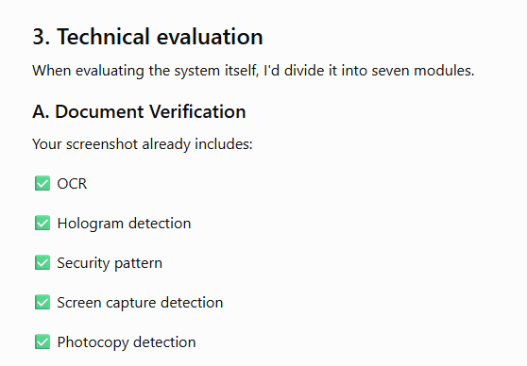
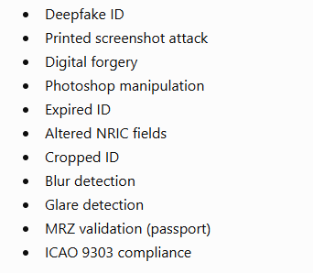

Slide 5
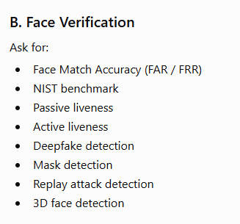
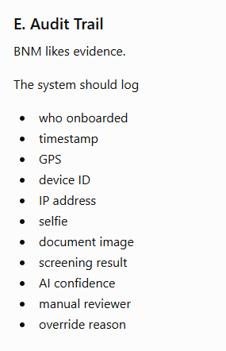
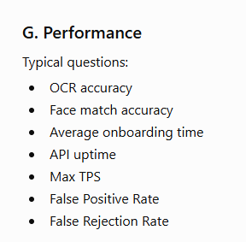
3. Compulsory requirement

Slide 6
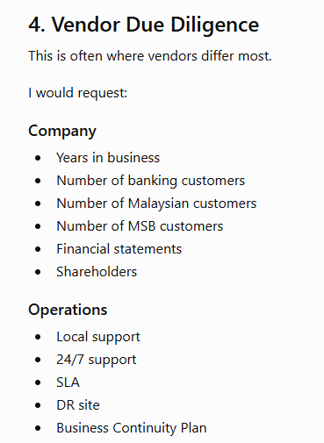
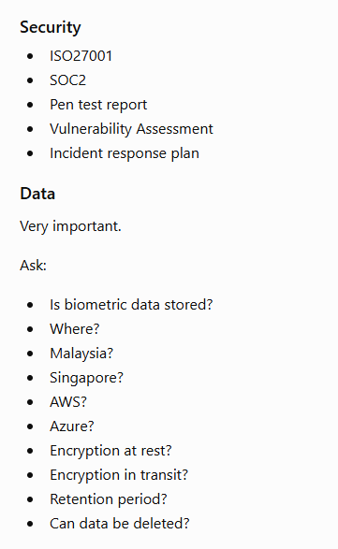

Slide 7

Category | Weight
BNM Compliance | 25%
Security & Certifications | 20%
AI Accuracy | 20%
Fraud Detection Features | 15%
API & Integration | 10%
Vendor Experience | 5%
Cost | 5%

